Slide 1

Capstone Design Review Presentation

Slide 2
Add slide title
Designing and Evaluating a Retrieval-Augmented LLM System
Capstone Design Review Presentation
• Domain & Corpus: Enterprise Q&A Assistant bounded strictly to local 'WikiFiles' Wikipedia text corpus.
• Core Capabilities: Hybrid retrieval (BM25 + Chroma Vector DB), semantic Q&A caching, multi-query decomposition, and multi-turn state tracking.
• Security Infrastructure: Pre-retrieval fake-WikiFile injection detection and fail-closed persona filtering.
• Framework & Orchestration: LangGraph StateGraph agent with role-based model routing (OpenAI GPT-5.4).
Notes:
Domain- this is a question-and-answer assistant strictly scoped to locally stored Wikipedia text files
Retrieval system is based on 1. Text based retrieval, BM25. 2. vector DB which is stored in Chroma db. and 3. semantic of question and answers are also caches for faster retrieval and cost optimization. 4. queries are decomposed in multiple smaller queries and each query passes through retrieval system separately.
From security point of view, there are 2 important guardrails implemented- 1. Fake wikifile injection detection 2. persona filtering or role-playing
To implement this system- StateGraph from LangGraph is used along with many other classes and libraries.

Slide 3
The Problem
What Problem Does It Solve?
Who is the Intended User?
Why is this Problem Important?
Unbounded LLM Speculation & Attacks
• General-purpose LLMs hallucinate unverified facts and speculate beyond official enterprise documentation.
• Standard RAG pipelines succumb to adversarial context poisoning (e.g. fake WikiFile blocks) and persona hijacking.
• Complex/lengthy questions fail in single-pass search without structured query decomposition.
Enterprise Knowledge Workers
• Enterprise researchers and technical auditors needing guaranteed factual accuracy.
• Internal teams querying domain-specific local document repositories ('WikiFiles').
• Users requiring interactive, multi-turn follow-up capabilities with context awareness.
Trust, Compliance & Reliability
• Zero Tolerance for Speculation: Critical business queries require 100% source-grounded responses.
• Security Compliance: Prompt injections can exfiltrate data or invert factual model outputs.
• Operational Efficiency: Automated caching and query splitting drastically reduce response latency.
Notes:
What problem this system addresses is- LLM may hallucinate or generate the false fact or just speculate if query is domain specific and answer is expected within the scope of organizations’ documents.
As far the users of this system are concern- it is open to anyone within the organization who is seeking the fact-based answers and expects accuracy while seeking the answers based on company specific domain are right users for this RAG system. History is also maintained in a session for contextual reference.
For any organization Trust, compliance and reliability are the keys for any retrieval system. Businesses cannot trust a system if its source is unknown, it speculates…
when System is not secure enough, there is possibility that facts are doctored via prompt injections…
Caching and query splitting implemented in this system improves response time significantly
This RAG system addresses all such problems, will see in coming slides….

Slide 4
Retrieval and Evaluation
Retrieval Strategy & Fusion
RAGAS Evaluation Framework
• Hybrid Fusion: Combines BM25 keyword search with Chroma vector embeddings (0.5/0.5 weight normalization).
• Topic Retrieval (`by_topic`): Fetches up to 70 files directly matching specific topic keywords (e.g. 'Apollo 11').
• Graph Augmentation: NetworkX graph traversal (`GraphRetriever`) walks `relates_to` topic edges and `belongs_to` thread edges.
• Automated Benchmark Harness: Evaluates system accuracy against a predefined JSON file with questions and grounded notes
• LLM Judge Metric: Uses `gpt-5.4-mini` as an automated judge scoring `DiscreteMetric` ('pass'/'fail') against grading notes.
• Multi-Retriever Comparison: Directly benchmarks BM25, Vector, Hybrid, and Graph retrieval strategies.
Representative Results
Strengths and Limitations
• Pass Rate Superiority: Hybrid & Graph retrievers achieve significantly higher pass rates over pure BM25 or vector baselines.
• Topic File Precision: `retrieve_by_topic_node` achieves 100% file coverage on named enterprise topics.
• Strict Non-Hallucination: Bounded prompts correctly output refusals on out-of-scope evaluation questions.
• Strengths: Robust multi-step reasoning, zero hallucination on missing facts, instant caching for repeated queries.
• Limitations: Batch evaluation mode cannot collect live clarification inputs (`[no clarification available in batch mode]`).
• Trade-off: Multi-step planning loops increase API token overhead (~91.7:1 input-to-output token ratio).
Notes:
As retrieval strategy- Hybrid fusion is used where keyword-based search which is BM25 is fused with semantic based search which is Chroma vector embeddings at equal ratio.
There are multiple Wikipedia text files on a related topic kept in source folder, topics are mentioned in file name.
Graph has multiple nodes like- Plan, retriever, by date, by topic, clarify and answer… plan is the entry point
While traversing through graph by topic, max70 files on a topic are selected to control the limits and I guess 70 is a optimal number in this scope
For creating a graph, Networkx library is used
---
System by design also supports its evaluation. If user selects the mode at the start for evaluation, a predefined test file with questions and their grounded notes are provided in JSON format. The retrieved response is judged by the LLM and marked as Pass or fail in generated output. Each query is retrieved using 4 technique - bm25, vector, hybrid and graph strategy…. We will see the evidence later
---
As an observed fact, Hybrid & graph retrievers' performance better, but in a particular case it is also observed that when Hybrid retriever fails the vector search returns the correct answer. It is because hybrid retriever is diluting because of its K-limit
System retrieves 100% answers within the source provided
---
Caches improves the response time and optimizes the cost. That is the strength of the system.
When system is running in batch mode for evaluation- there is no option to provide the clarification which I see as limitation as of now
In a graph technique- the plan node is the starting point and decision making sometimes may increase the usage of the API token

Slide 5
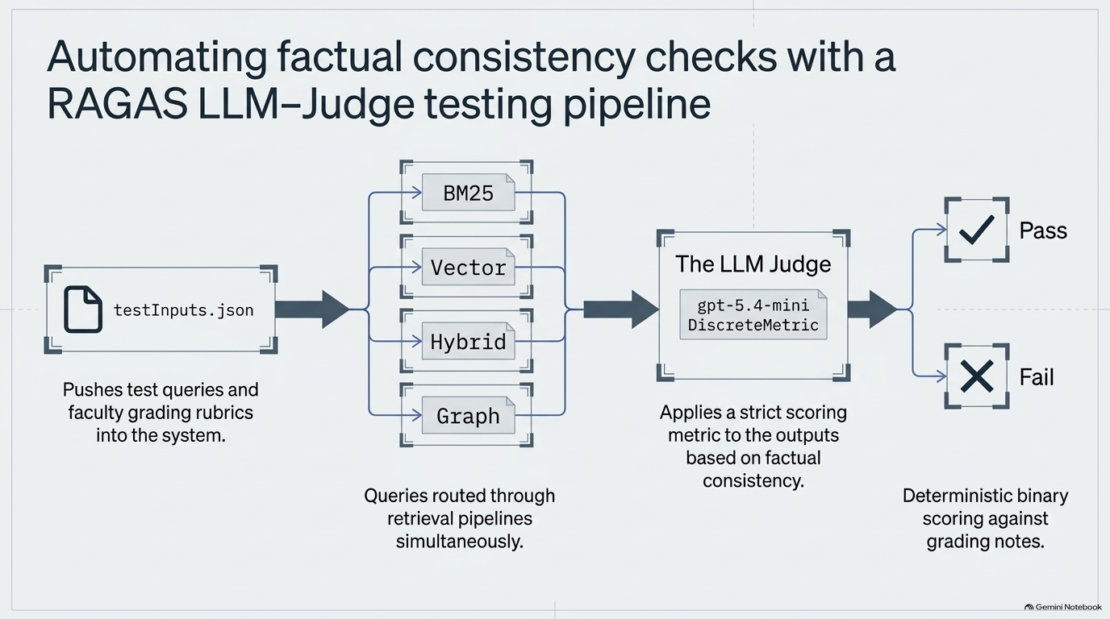
Notes:
This is just a visual presentation of last slide,
For evaluation- a testInput.json is used as discussed in last slide. The query passes through for all 4 techniques and retrieves the answer which is evaluated by same or higher version of LLM as judge. But in my version of code Judge is also same LLM. Judge LLM mark the answer as Pass or fail which is later written on file. RAGAS library is used as facilitator

Slide 6
Engineering Decisions
Decision 1: LangGraph Stateful Agent vs. Static Single-Pass Retrieval
• Design Rationale: Static RAG pipelines fail when queries require multi-step reasoning or user clarification. LangGraph provides state persistence (`_AgentState`), enabling iterative tool selection, query decomposition, and multi-turn conversation memory.
• Trade-offs & Alternatives: Single-pass retrieval is faster but misses multi-part answer context. Multi-step planning increases token consumption (~91.7:1 input/output token ratio) but ensures answer completeness.
Decision 2: Pre-Retrieval Defense Stack with Fail-Closed Persona Filter
• Design Rationale: Attacks like fake WikiFile injection (`BEGIN FIRST WIKI-FILE BLOCK`) must be blocked before reaching vector storage or LLM planners. The persona filter uses a lightweight LLM (`gpt-5.4-nano`) operating under a strict fail-closed security policy.
• Trade-offs & Alternatives: Fail-open design risks leaking prompt injections during API outages; fail-closed prioritizes security compliance over temporary filter unavailability.
Decision 3: XML Trust Hierarchy & Per-Role Model Routing
• Design Rationale: Enforces strict prompt boundaries (`SystemMessage` > `<retrieved_wikifiles>` > `<user_question>`). Per-role routing deploys high-reasoning models for planning (`gpt-5.4-mini`) and lightweight models for direct lookup/caching.
• Trade-offs & Alternatives: Uniform expensive models (e.g. GPT-5.2 Pro) incur 10x-50x higher API costs ($0.98 vs $0.0151 per run) without improving answer formatting quality.
Notes:
Decision 1 using lang graph stateful agent over static single pass retrieval- single pass retrieval is faster and multiple part planning increases token consumption also but multipart ensures the completeness of answer retrieved.
Static pipeline fails when query requires multi step reasoning or user’s clarification. LangChain provides the query decomposition and multi turn conversation memory
---
Decision 2 Guardrails are in place to provide pre-retrieval defense against fake-file injection from prompt- and role-playing attacks. It is blocked even before reaching to LLM planner. Although Persona filter uses a lightweight LLM
---
Decision 3 XML Trust Hierarchy- XML enforces strict boundaries among System Message, Retrieved Wikipedia files and, User Questions. Light weight model is used for direct look up and caching. Still API cost is higher because of expensive models while answer’s quality is still same

Slide 7
Limitations and Future Improvements
Remaining Limitations
Known Operational Risks
Future Roadmap & Enhancements
• Batch Evaluation Clarifications: In benchmark mode (`mode='batch'`), `clarify_node` cannot collect live user input and appends default static text.
• Filename-Based Date Extraction: `retrieve_by_date` relies on strict filename patterns (`wiki_MM_DD_YY.txt`) rather than internal document metadata.
• Regex Sanitization Over-breadth: Header stripping regex (`_WIKIFILE_HEADER_RE`) could strip legitimate user text that resembles email headers.
• Chroma Vector Re-indexing: Re-building the Chroma vector database on corpus updates adds startup latency during initial system load.
• Integrated Graph Tool Node: Embed NetworkX graph traversal (`GraphRetriever`) directly as an agent tool node inside `StateGraph`.
• Automated Query Relaxation: Implement query relaxation in `clarify_node` during batch evaluation to auto-resolve ambiguous benchmark prompts.
Notes:
Limitation:
it cannot collect user’s input for clarification in Batch mode
Retrieve by date or by topic relies on file name rather some more reliable source like file’s metadata
Risk:
Header stripping regex can strip the legitimate user text also
At the startup, building Chroma vector DB creates delay
Enhancement:
May embed Networkx graph traversal directly as an agent tool node inside the StateGraph
Implement auto resolve ambiguity in user’s query in Clarify Node
Implement a web-based user interface, so that users from the organization can easily access this RAG system and Admin can control to run the Evaluation part, it is not required for end users.

Slide 8
Evidence
**Who approved it?**
The supplied WikiFiles do not name a specific individual or body that formally approved the Apollo 11 mission. The documents describe the mission’s planning, goals set by President John F. Kennedy, and the NASA teams that executed it, but they do not record a definitive approval authority.
**When was it launched?**
Apollo 11 launched on **16 July 1969 at 13:32:00 UTC** (9:32 am EDT) aboard the Saturn V SA‑506 from Launch Complex 39A at Kennedy Space Center.
You: How do you define Apollo 11 as success or failure?
Assistant: The provided WikiFiles do not contain information that defines Apollo 11 as a success or a failure.

Slide 9
Evidence
==============================================================================
EXPERIMENT: BASELINE — un-optimized full agent (no cache, no router)
==============================================================================
Loading existing vector DB from chroma_db/
Q1. Tell me something about Apollo 11?
-> Apollo 11 was the American spaceflight that first landed humans on the Moon. It launched on July 16, 1969, with Neil Armstrong, Buzz Aldrin, and Michael Coll...
Q2. What was decided about the government project?
-> The e-mails indicate that it was decided the commander would be the first to exit the spacecraft and walk on the Moon. In Apollo 11’s case, that meant Neil A...
Q3. Who was Nikita Khrushchev?
-> Nikita Khrushchev was the Premier of the Soviet Union. In the emails, he is mentioned as the Soviet leader whom President Kennedy met with in June 1961, and ...
Q4. Why did Armstrong refused to put their names on emblem?
-> Armstrong and the others decided not to put their names on the Apollo 11 patch so it would “be representative of everyone who had worked toward a lunar landi...
Token usage:
openai/gpt-5.4-mini: 62643 input, 776 output, 0 cached
==============================================================================
EXPERIMENT: OPTIMIZED — semantic cache + query router
==============================================================================
Loading existing vector DB from chroma_db/
Q1. Tell me something about Apollo 11?
-> Apollo 11 was the American spaceflight that first landed humans on the Moon. It launched on July 16, 1969, and the crew were Neil Armstrong, Michael Collins,...
Q2. What was decided about the government project?
-> The e-mails do not mention a government project decision. They only say that NASA officials hoped the space program could spur progressing other areas, such ...
Q3. Who was Nikita Khrushchev?
-> The e-mails identify Nikita Khrushchev as the Premier of the Soviet Union.
Q4. Why did Armstrong refused to put their names on emblem?
-> Armstrong and the others decided not to put their names on the patch so it would be “representative of everyone who had worked toward a lunar landing.”
Token usage:
openai/gpt-5.4-mini: 27148 input, 283 output, 3840 cached

Slide 10
Thanks
Thank You for Your Review!
Git repo path: https://github.com/merasupermarket/RAG-WITH-MIT-XPRO
YouTube: https://youtu.be/6zxbiw4zetw

